Slide 1
The Use of the Targets by the Institutions & Development Implementation Board in Monitoring the Work Plan Implementation
2nd GEOSS Science and Technology Workshop Plenary Session P4: GEOSS Strategic Targets and Their Alignment to MDGs and Global Sustainability Research.
August 28-31, 2012 in Bonn, Germany

Slide 2
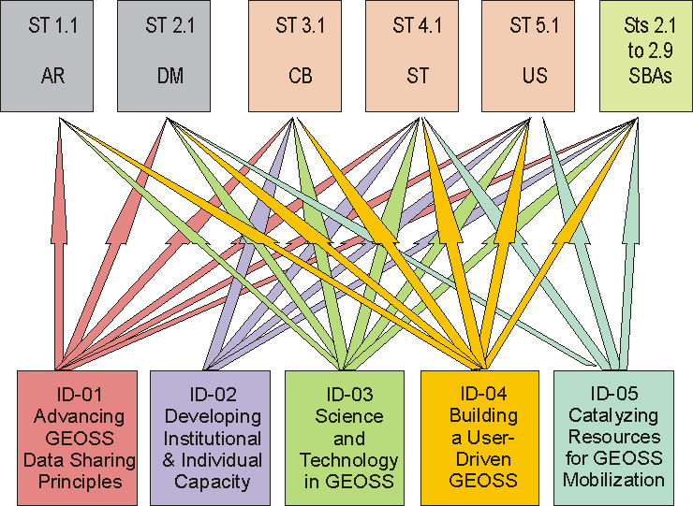
I&D Relationships to Targets (Initial Report to ExCom)
Notes:
The I&D Tasks will contribute to many of the Targets.

Slide 3
Example--I&D Relationships to Targets (Initial Report to ExCom)
Relations of ID-01, Advancing GEOSS Data Sharing
Principles, to 2015 GEOSS Strategic Targets
Strategic Target 1: Architecture
Task contributes to the provision of the essential environmental observations and information and facilitates access to, and the use of, these observations and information.
Notes:
Our initial view on "HOW" they contribute is in the report to ExCom and here are a few examples: one of many from ID-01

Slide 4
Example--I&D Relationships to Targets (Initial Report to ExCom)
Relations of ID-03, Science & Technology in GEOSS, to 2015 GEOSS Strategic Targets
Strategic Target 5:
ID-03 focuses on understanding critical user information needs for decision making for S&T users and works to have these needs recognized and met through Earth observations.
Notes:
Our initial view on "HOW" they contribute is in the report to ExCom and here are a few examples: one of many from ID-03.

Slide 5
Example--I&D Relationships to Targets (Initial Report to ExCom)
Relations of ID-05, Catalyzing Resources for GEOSS Mobilization to 2015 GEOSS Strategic Targets
Strategic Target 3:
Leveraging resources of Earth observation capacity building efforts. Ensuring the engagement and committed involvement of resource providers in the GEO capacity building process.
Two task objectives relate to this target:
i) Identification of opportunities in existing programs and mechanisms for resourcing capacity building initiatives (measured by counting the opportunities, with an indication of the related budgets and an indication of the suitability and accessibility of these opportunities for funding of GEOSS-related activities, supported by stories on successful experiences),
ii) Establishment of an active brokering mechanism between resource providers with GEO and the GEOSS agenda being communicated to funding agencies .
Notes:
Our initial view on "HOW" they contribute is in the report to ExCom and here are a few examples: one of many from ID-05.

Slide 6
Example--I&D Relationships to Targets (Initial Report to ExCom)
Relations of ID-02, Developing Institutional & Individual Capacity, to 2015 GEOSS Strategic Targets
Strategic Target 3: (Six target objectives specified)
These targets are expected to be achieved through increase synergies and effectiveness of capacity building programmes; involvement of resource providers, and integration of EO information systems in decision-making . . . . (more detail)
Notes:
Our initial view on "HOW" they contribute is in the report to ExCom and here are a few examples: one of many from ID-02.

Slide 7
Qualitative Relationships Mostly
Notes:
.The contribution is qualitative for the most part.

Slide 8
Qualitative Relationships Mostly
WHAT CAN BE
QUANTIFIED ? ? ?
Notes:
.We need to determine what are the quantitative contributions, if any, . . .

Slide 9
Qualitative Relationships Mostly
ARE THESE GOOD
METRICS ? ? ?
Notes:
.We need to determine what are the quantitative contributions, if any, and come up with metrics, where possible.

Slide 10
Cross-Task Integrations at the Targets What Integrated Outputs? Outcomes?
Notes:
.We also need to determine if the contributions can be integrated into a more comprehensive output and show clearly how they address the outcomes in the Targets and produce benefits under the Targets.

Slide 11
Cross-cutting Aspects have been Identified (presented in random order)
Establishment of LINKAGES across SBAs.
Establishment of PARTNERSHIPS within SBAs.
DEVELOPMENT of INFORMATION & DATA for socio-economic benefit and D-M.
USE of earth observation products & services, integration of EOsystems in D-M.
PROMOTION of research and development, and capacity building.
Research and development for MODELs, data assimilation and algorithms.
Promote development from RESEARCH TO OPERATIONS.
SENSOR validation and verification.
Science and technology to improve OBSERVATION.
Promote INTEROPERABILITY of observing systems.
SOCIETAL needs in new RESEARCH.
Increase SYNERGIES and effectiveness of CAPACITY building programs.
Involvement of RESOURCE providers for CAPACITY building.
Full and open exchange of data, metadata and products, available with minimum time delay and at minimal cost (SHARING)
Special attention to participation of, capacity building in Earth observation in, and development of Earth observation for decision-making in, DEVELOPING COUNTRIES.
Notes:
Here is an approach proposed by ID Board Co-chair Mark Noort.

Slide 12
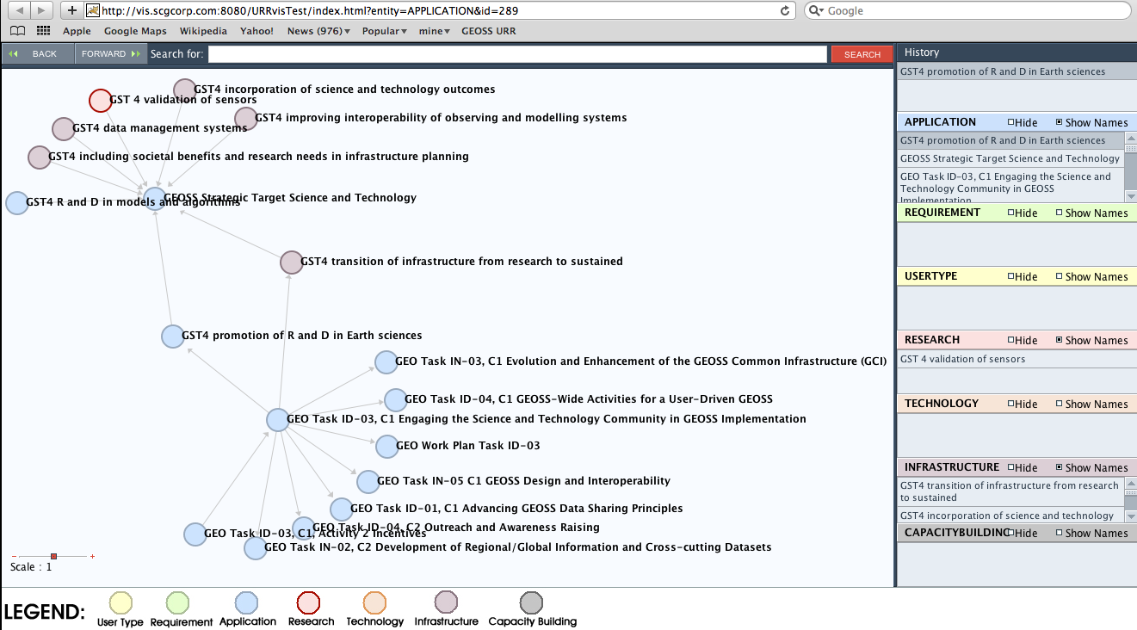
Preliminary Representation-ST4 & ID-03 C1 Cross-cutting Applications, Needs & Links
Notes:
Here is an approach proposed by ID Board member Hans-Peter Plag using a visual tool in the URR. As we look at integration we also need to identify gaps that hinder the integration or where nothing is going on to address the Targets.

Slide 13
THANK YOU
QUESTIONS
COMMENTS
ADVICE
Notes:
We still have a great deal of work to do and we welcome any help.

